Slide 1

Entering Exceptions and Milestones into the
Academic Requirements Reports
Office of the Registrar
This is a narrated presentation. Please enable audio.

Slide 2

General Information about this Training
While anyone can participate in this training, access to enter exceptions and milestones is limited to academic advisors within departments that offer degrees.
Completion of the Academic Requirements Overview training and submission of an access request form to the Crimson Service desk is required to obtain access to enter exceptions and milestones. If current access is incorrect, contact crimsonservicedesk@wsu.edu.
“AR” is used throughout this presentation to designate the Academic Requirements. (Also known as advisement report or degree audit).

Slide 3

General Exceptions Rules
Advisors can only enter exceptions for their Major/Minor/Certificate Requirements.
The Graduations Area can enter exceptions to University Requirements under the following circumstances.
  Apply GER/UCORE crosswalk
  Apply HONORS/UCORE crosswalk
  Apply 500 level courses to undergraduate credit
  Approved petition from the Office of Undergraduate Education.
Requirements using in-progress courses must have a minimum grade point

Slide 4
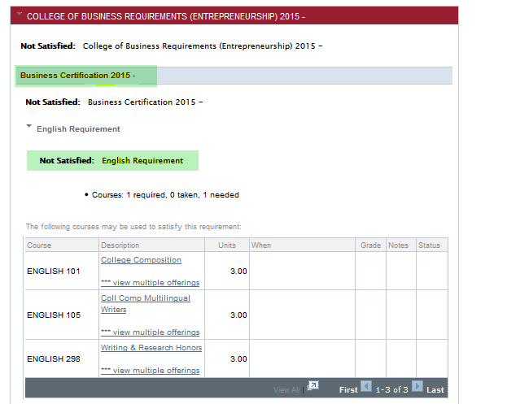

Identify the Requirement Line
You will need to open two browsers
Open the Academic Requirements and locate the requirement line for the exception.
There are 3 requirement line levels for every exception. Here they are:
College of Business Requirements
Business Certification
English Requirement

Slide 5
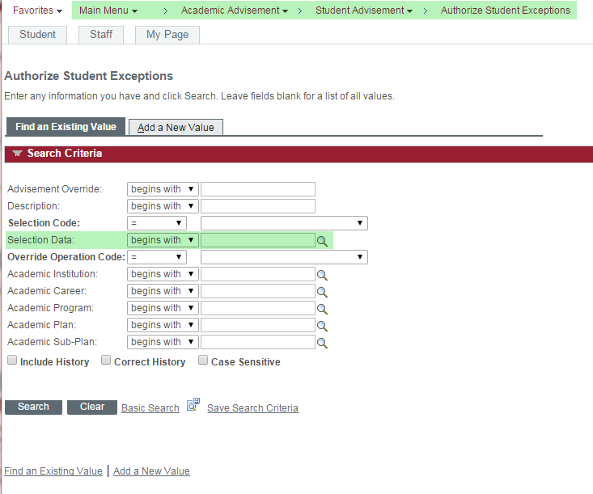

Look for Existing Exceptions for the same Requirement Line
In a new browser, Open the exceptions screen by going to: Main Menu > Academic Advisement > Student Advisement > Authorize Student Exceptions.
Check to see if the student has any current exceptions by entering the SID# into the Selection Data
Click Search.

Slide 6
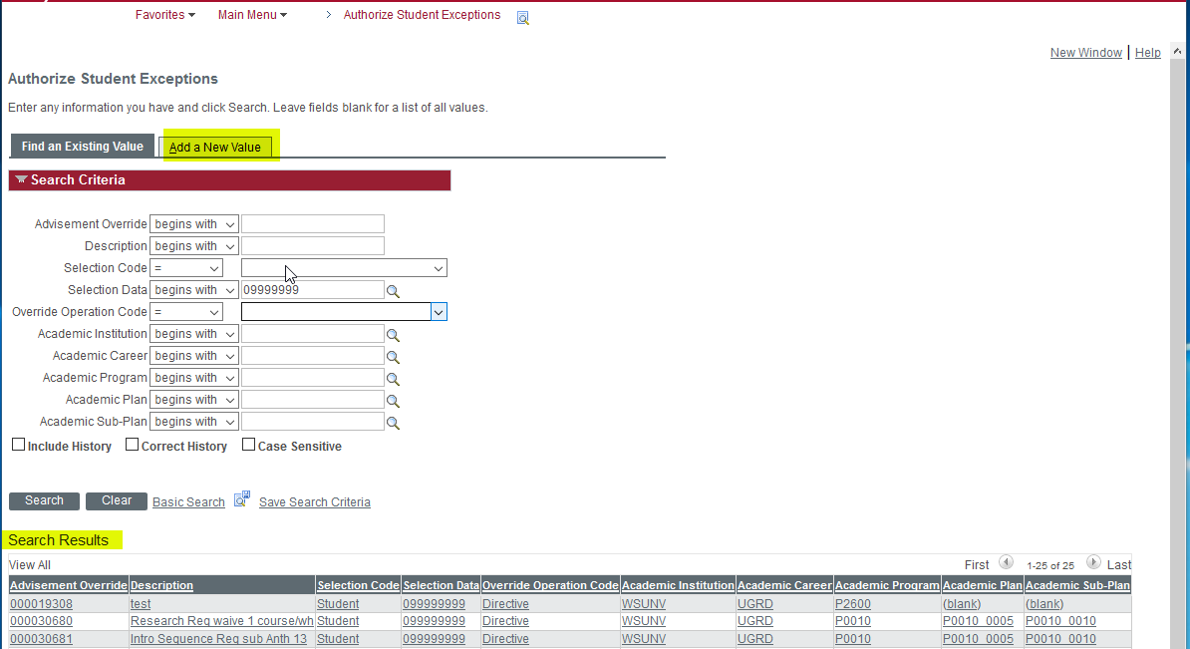

3) If current exceptions are found, check to see if your requirement has a current exception already created. You cannot have two exceptions for the same requirement line. You can add to an existing directive exception.
Look for Existing Exceptions for the same Requirement Line
Enter student ID into the Selection Data Field
Review existing exceptions for a description for the same requirement.
If NO current exceptions for the same line are found in the search, Click Add a New Value.

Slide 7
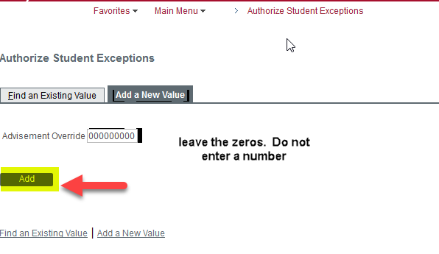

Creating a New Exception
When Adding a New Value do NOT enter anything in the advisement override field. The override number will be added automatically.
Click Add.

Slide 8
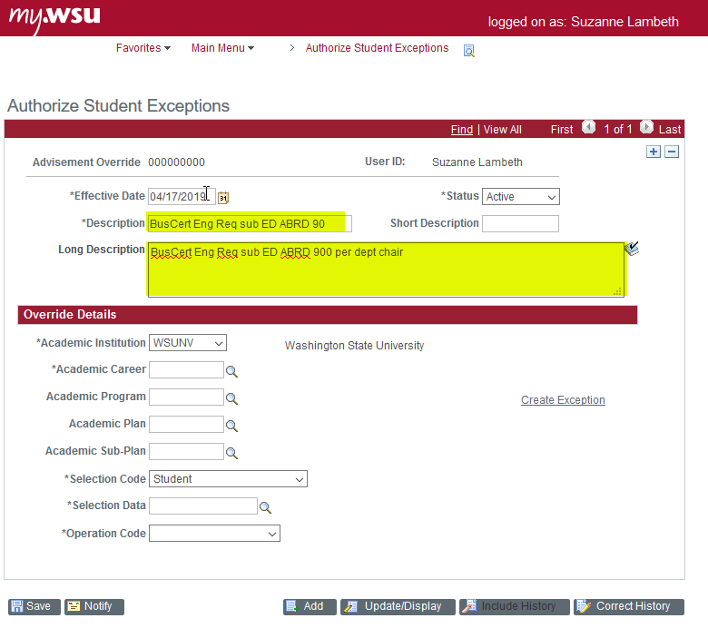

Creating a New Exception
Enter a Description of the Requirement and what action you are performing based on the list below. To prevent delays during the graduations area review of the Academic Requirements, always include a Long Description.
The description should start with the requirement line. Enter into the long description and then copy and paste into description.
Example of Description: BusCert Engl Req sub course xxx for English Requirement as per…

Slide 9
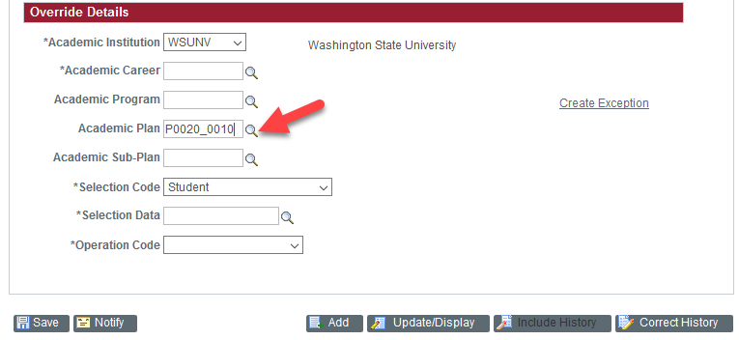
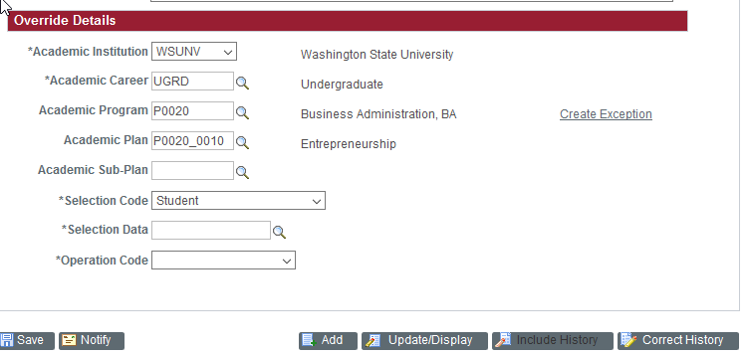

Creating a New Exception
Enter the Academic Plan.
  Click on the magnifier to choose the correct plan. The program will autofill and career will autofill.
Important- if the student is a post-bacc or an additional major – you must use the specific code for that plan.

Slide 10
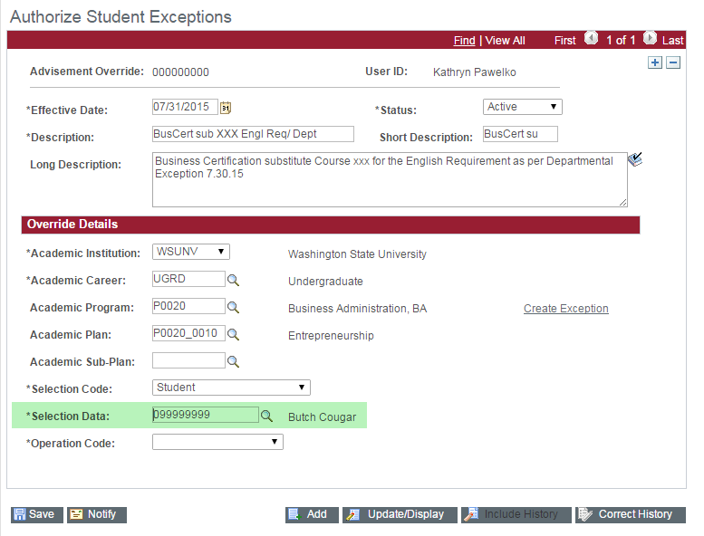

Creating a New Exception
Enter Student ID # into the *Selection Data

Slide 11
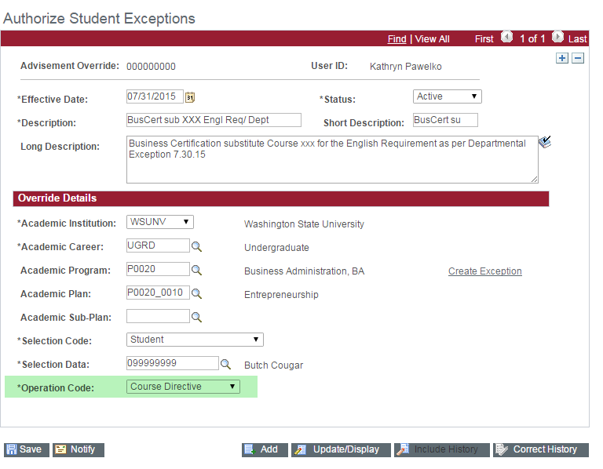

Creating a New Exception
Choose the *Operation Code (what the exception is going to do) from the drop-down menu based on the list below.
Course Directive: Substitute or exclude – directing to-or removing a course from- a requirement.
Requirement Change: changing the number of required courses or credits on a requirement line.
Requirement Override: For ESG - DO NOT USE.
Requirement Waiver: DO NOT USE

Slide 12
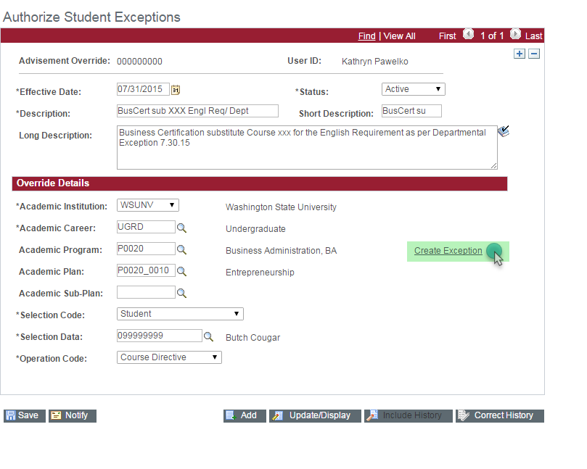
Creating a New Exception – Course Directive
Click Create Exception to move on to the next page.

Slide 13
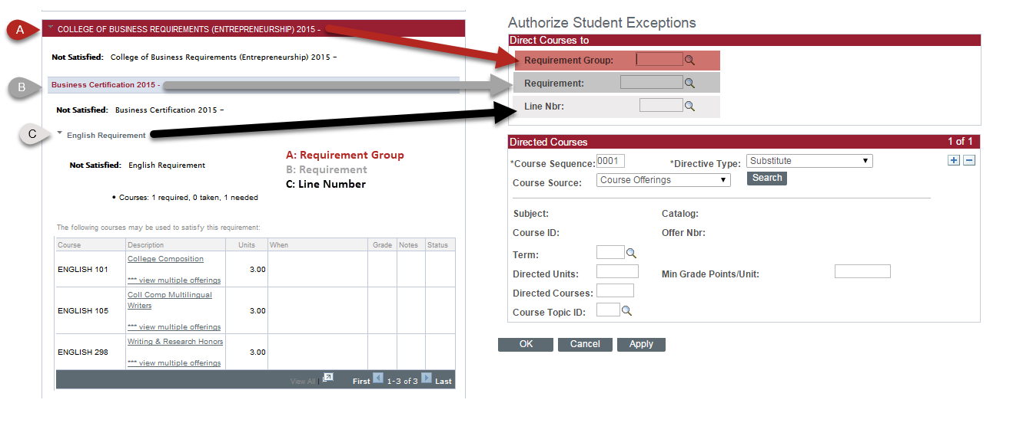

Choose the Requirement Group, Requirement, and Line Number based on the AR.
REMEMBER: RED, GREY, WHITE
Creating a New Exception – Course Directive

Slide 14
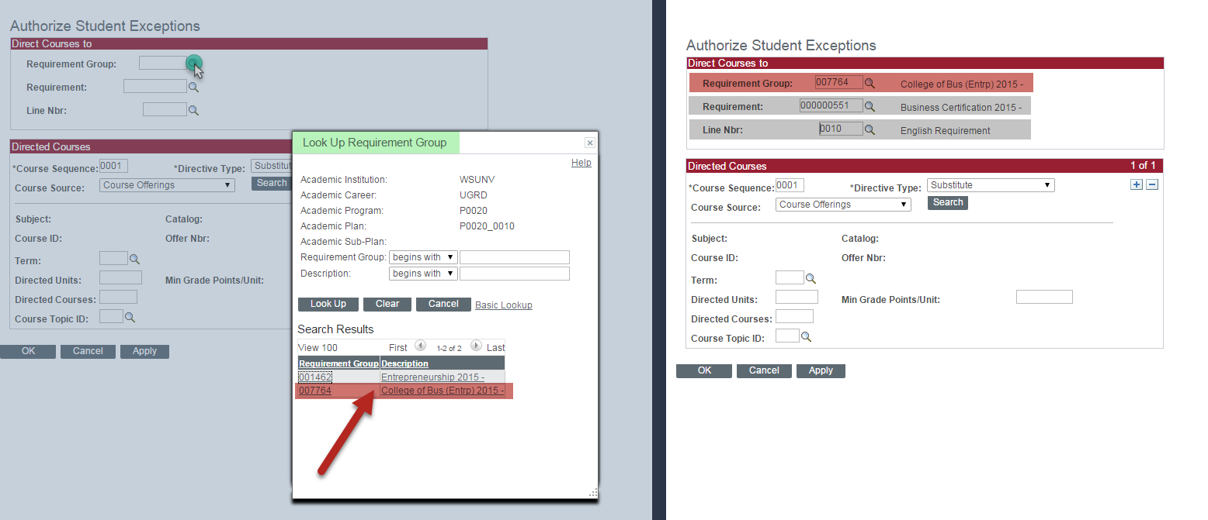

Creating a New Exception – Course Directive
Use the magnifier to select the appropriate requirement lines. Refer back to the Academic Requirements PDF to identify where the specific requirement resides

Slide 15
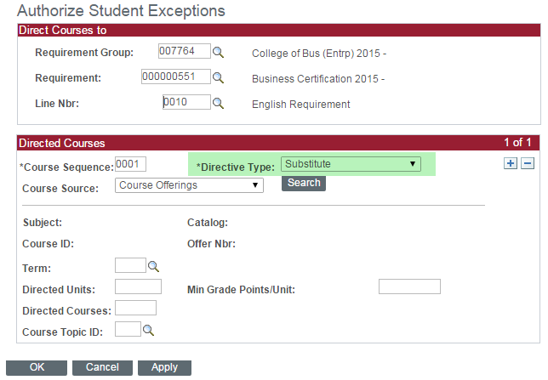

Creating a New Exception – Course Directive
Choose the *Directive Type.
  Substitute means that a course will be moved INTO a requirement.
  Exclude means that a course will be moved OUT of a requirement

Slide 16
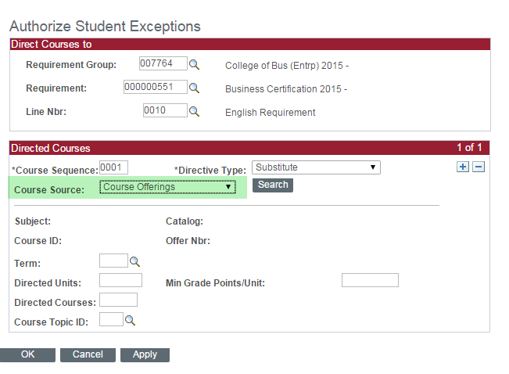

Creating a New Exception – Course Directive
Choose the Course Source
Enrollment:
Courses taken at Washington State University, Branch Campuses & Ed Abroad
Other Credit:
Credits assigned to the student transfer credit report that do not fit in other categories.
Test Credit:
AP Tests, Foreign Language Tests.
Transfer Courses:
Courses taken at another institution
Course Offerings:
Not used

Slide 17
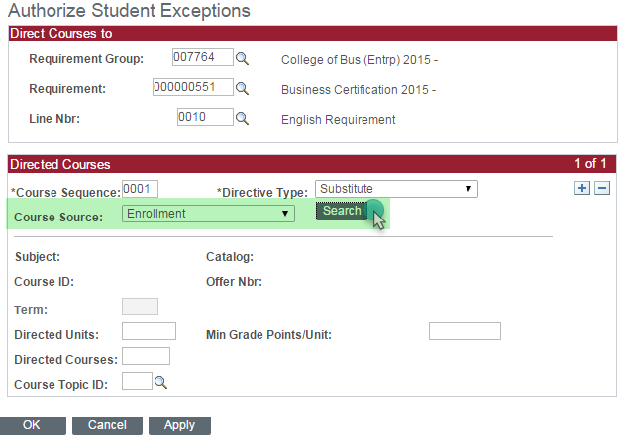

Creating a New Exception – Course Directive
Click Search

Slide 18
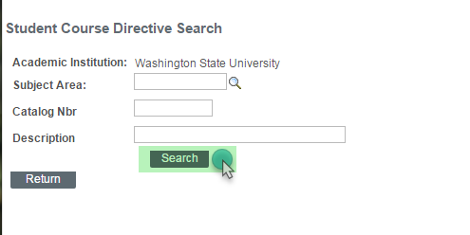

Creating a New Exception – Course Directive
Click Search
You do not need enter search criteria

Slide 19
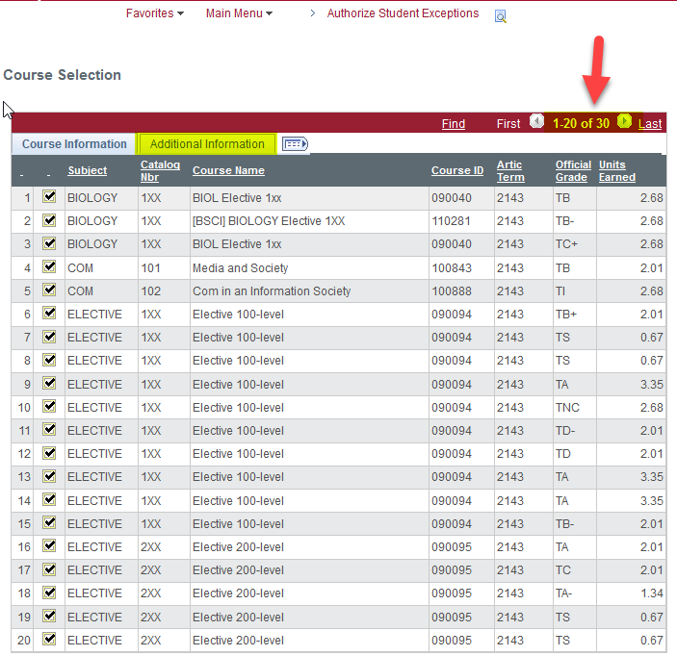
Creating a New Exception – Course Directive
Click on the checkmark next to the course to be used in the exception.
You may need to click View All or Additional Information to find the course.

Slide 20
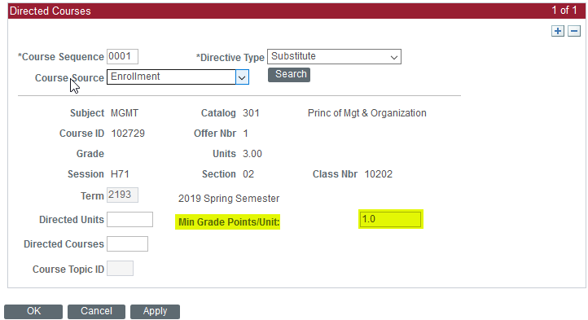
Creating a New Exception – Course Directive
Add Minimum Grade Points/Unit to Exception (of at least 1.0) – this ensures that W or F cannot satisfy a requirement.
Do not enter a value into Directed Units, Directed Courses or Course Topic ID

Slide 21
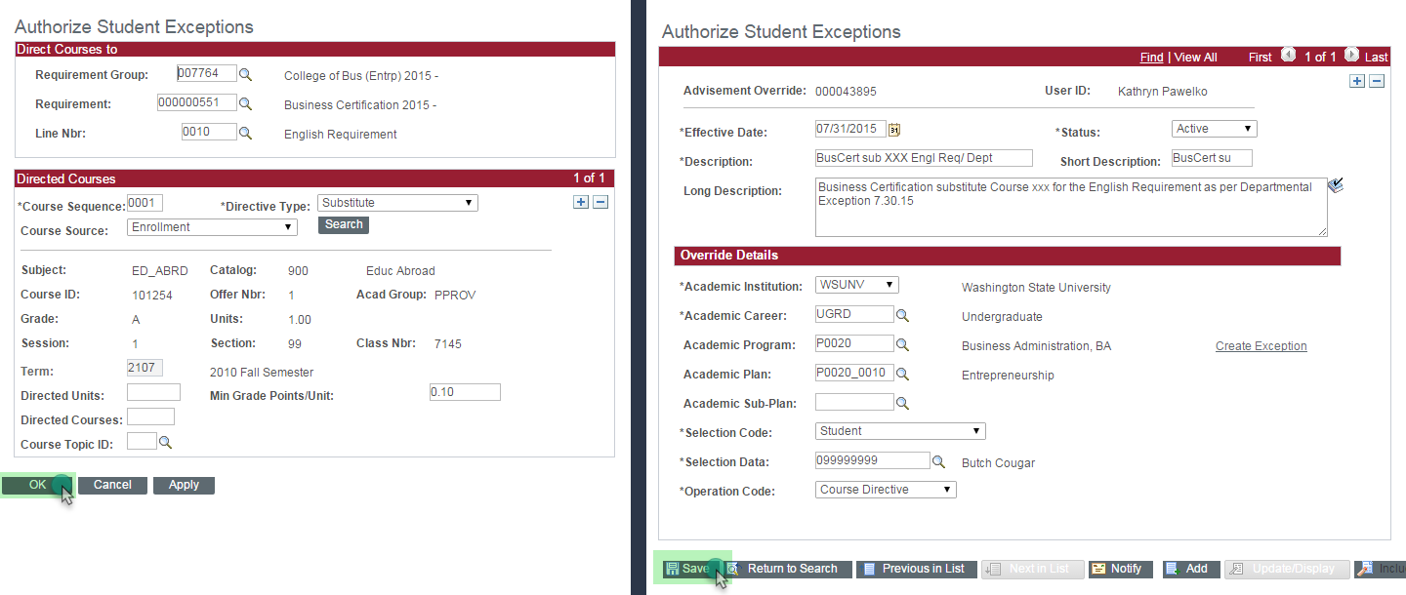

Creating a New Exception – Course Directive
Click OK, then Save

Slide 22
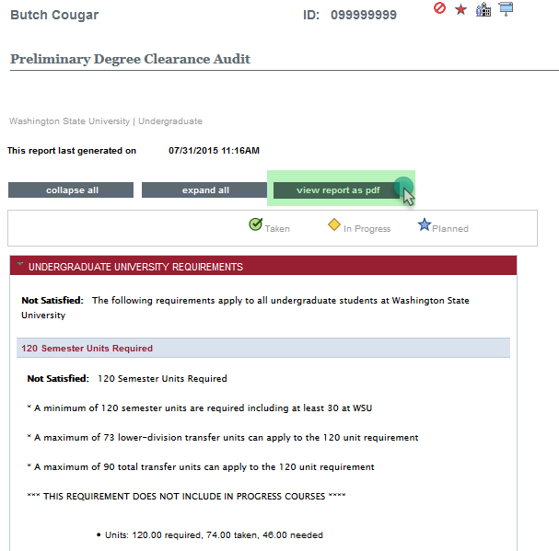
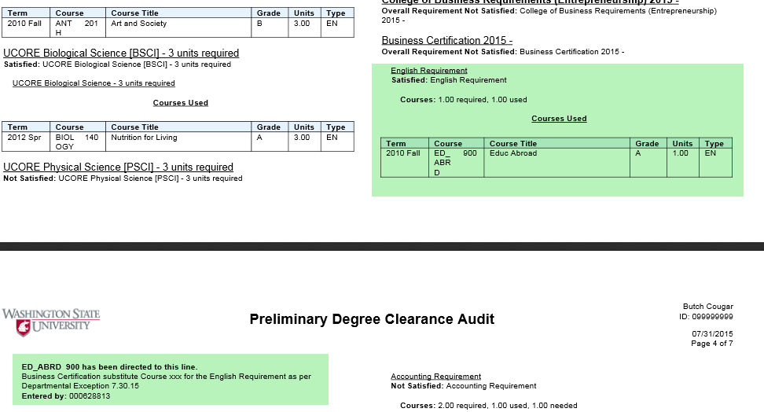

Creating a New Exception – Course Directive
Rerun the AR, open a PDF and check to see if the exception shows.

Slide 23

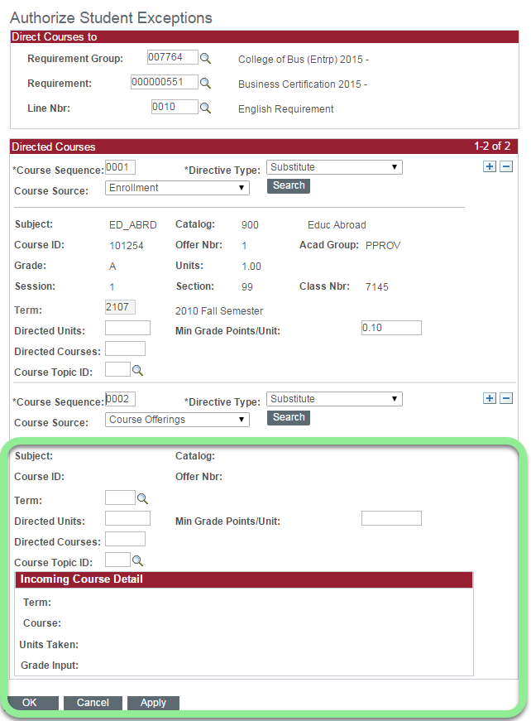
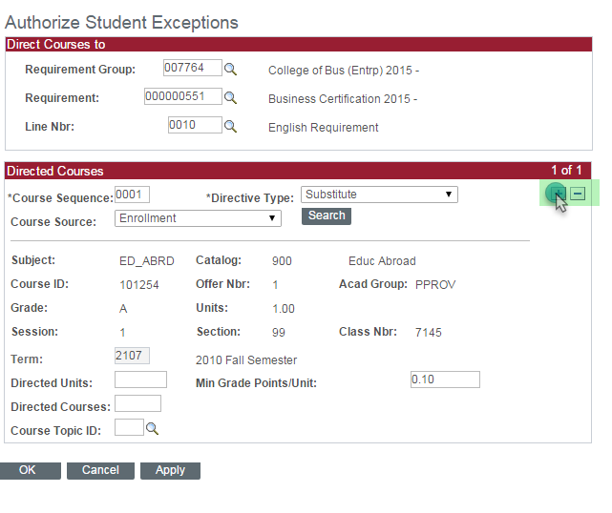
Creating a New Exception – Course Directive
If additional courses need to be added to a requirement do NOT create a new exception. Click the + on the second page of the exception. Follow the same procedures as before

Slide 24
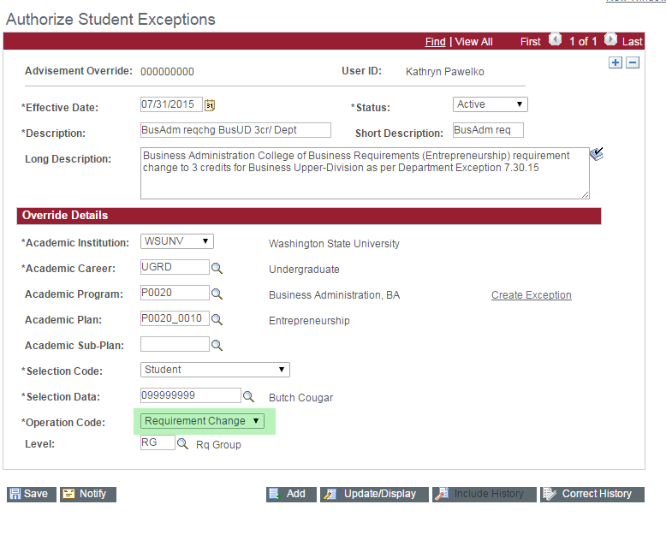

OTHER EXCEPTIONS – REQUIREMENT CHANGE
Choose Requirement Change in *Operation Code. This is used to change the number of courses or credits for a requirement.

Slide 25
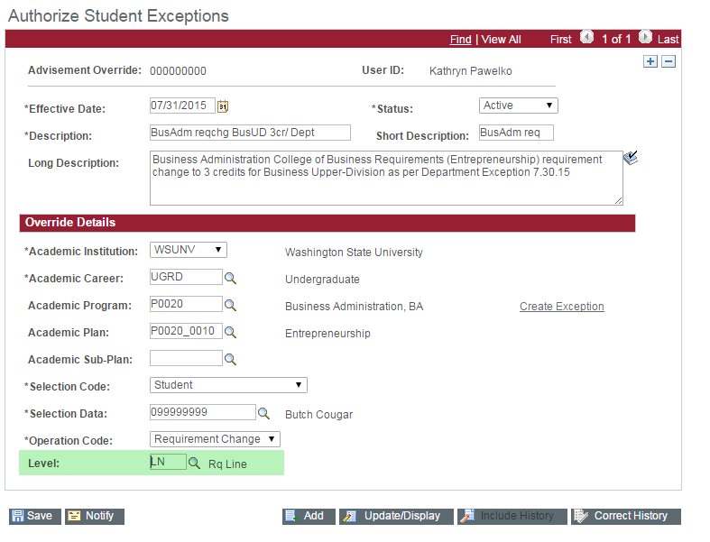

OTHER EXCEPTIONS – REQUIREMENT CHANGE
Level defaults to Requirement Group.
Change Level to Requirement Line (LN).
DO NOT use Requirement Group Level (RG).

Slide 26
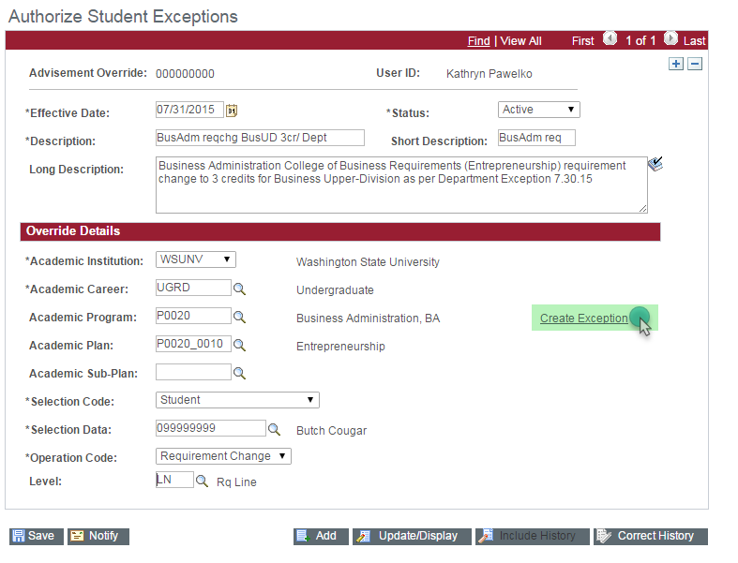

OTHER EXCEPTIONS – REQUIREMENT CHANGE
Click Create Exception to go to the next page.

Slide 27
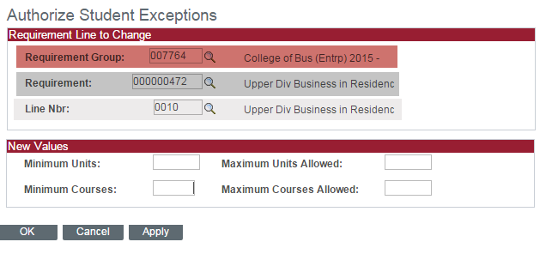

OTHER EXCEPTIONS – REQUIREMENT CHANGE
Make sure you have 3 requirement lines.
If you do not, you forgot to change the requirement Level from Requirement Group to Requirement Line.
Click cancel and change it on the first page of the exception.

Slide 28
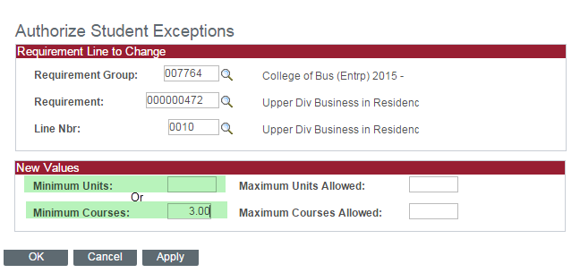

OTHER EXCEPTIONS – REQUIREMENT CHANGE
Choose Minimum Courses or Minimum Units (depending on Requirement).
Click OK, then Save.

Slide 29
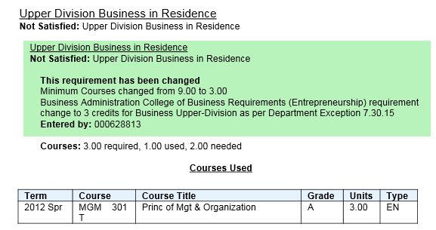

OTHER EXCEPTIONS – REQUIREMENT CHANGE
Verify that your exception worked!

Slide 30
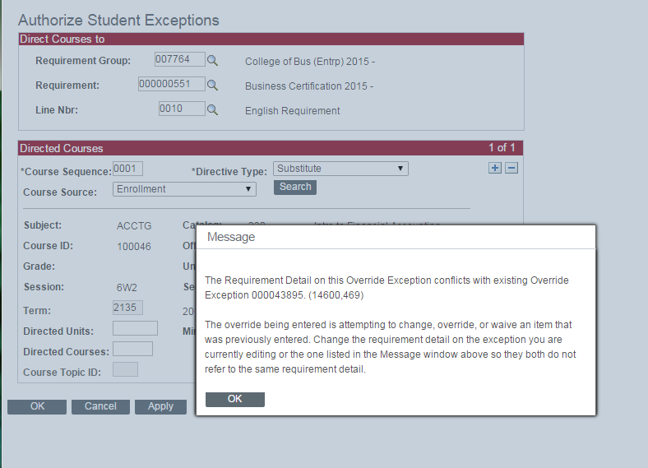
EXCEPTIONS SUMMARY
You CANNOT enter two course directive exceptions for the same Line Number. An Error Override message will appear. If you receive the Override Exception error, search for an existing exception and add your course to that exception

Slide 31
EXCEPTIONS SUMMARY
When entering a Requirement Change to change the number of courses required for a specific requirement - keep in mind that the Academic Requirements report is only looking for the total number of courses.
For example, if the requirement is 5 courses and it is changed to 4, the AR will satisfy the requirement if any 4 of the 5 approved courses are completed.

Slide 32
EXCEPTIONS SUMMARY
You cannot make changes to the first page of the exception once you have saved and closed the screen. It’s advisable to keep the exception screen open when you check to see if the exception worked. If you need to add text to an existing description, please contact the graduations area.

Slide 33
EXCEPTIONS SUMMARY
University Minor Requirements
Minimum of 16 credits
Minimum of 9 upper division credits in residency
Advisors have access to – but should not enter- changes to the upper division/residency requirement for undergraduate minors. Total credits cannot be reduced to fewer than 16. These are University requirements and can only be changed through University petition

Slide 34
EXCEPTIONS SUMMARY
If you are having to enter the same exception for multiple students, ask that your department review the graduation requirements – or see if moving the student to a more recent requirement term would be beneficial.

Slide 35

Entering Milestones

Slide 36

Entering Milestones
Milestones are Graduation Requirements that are not courses:
Portfolio
International Experience
Exit Survey
High School Foreign Language

Slide 37
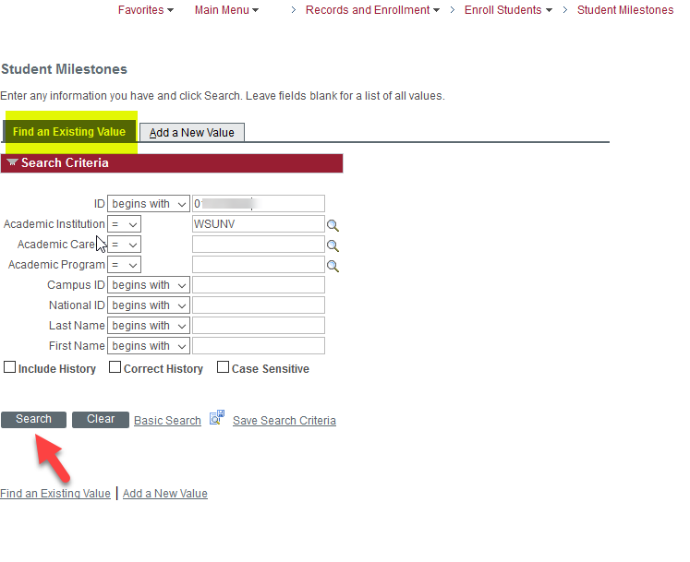

Entering Milestones
Navigate to the Milestones Page: Main Menu>Records and Enrollment>Enroll Students>Student Milestones
Enter the Student ID and click Search

Slide 38
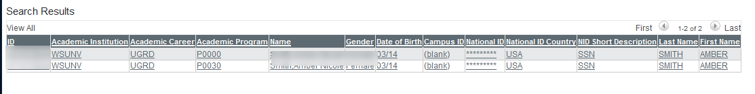
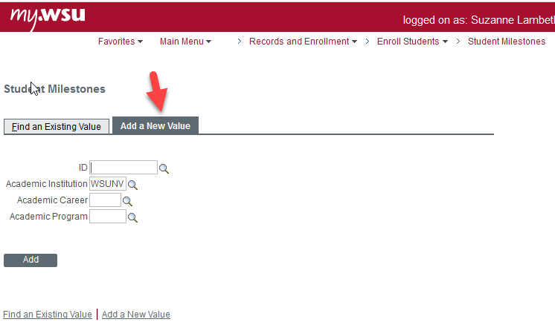

Entering Milestones
Select an existing value
Or Add a New Value

Slide 39
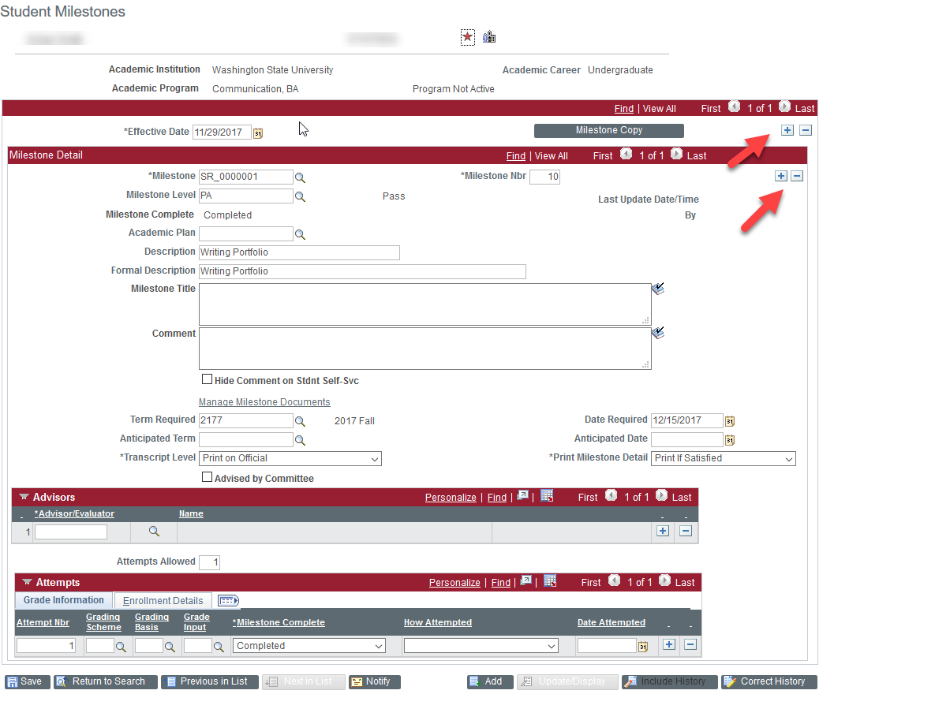

Entering Milestones
Click the + sign to copy the existing milestones
Click the + sign under Milestone Detail to add a new milestone
It is very important that you click both + signs or you will overwrite the existing milestone

Slide 40
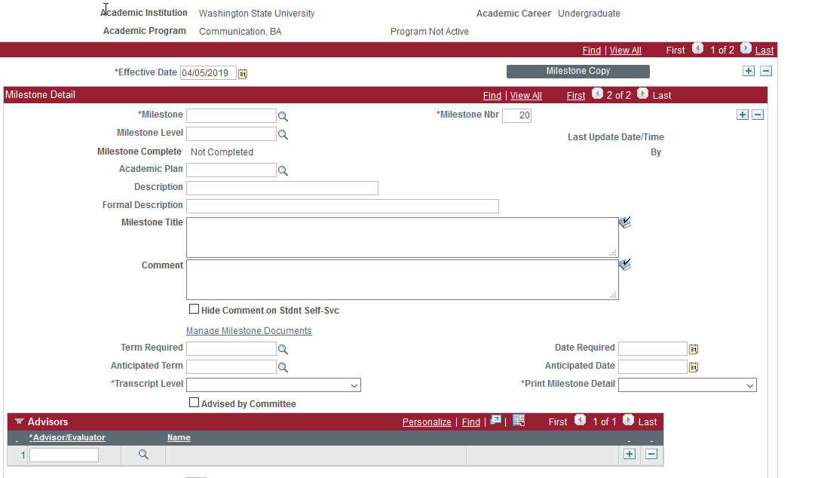

Entering Milestones
You should now have a blank milestone screen with the current date as effective date.

Slide 41
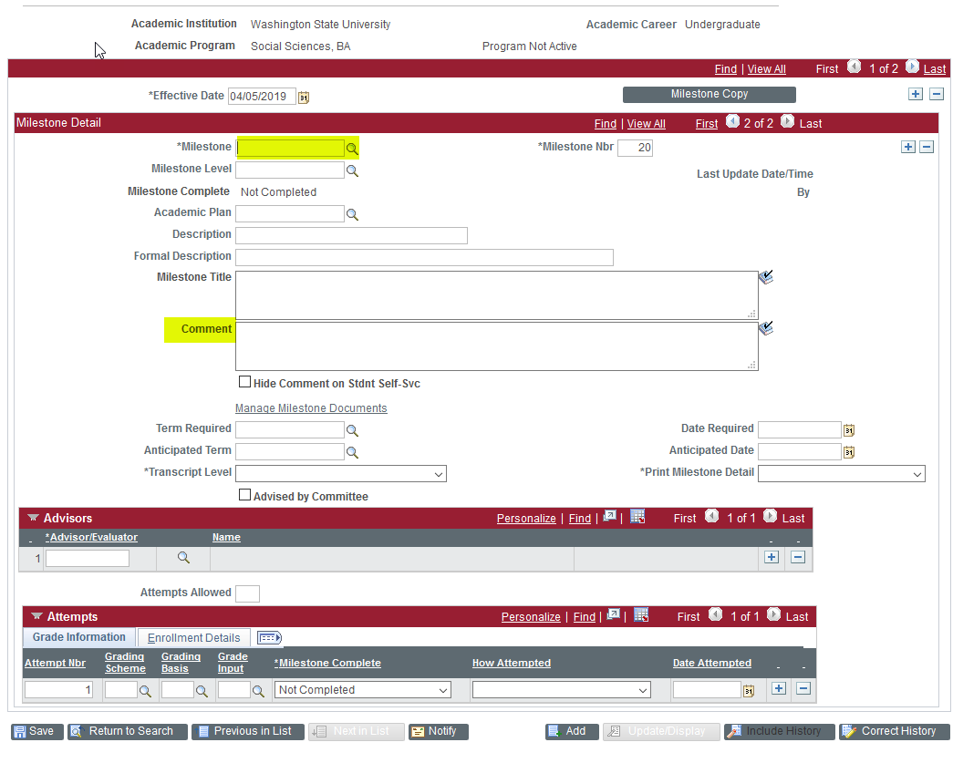

Entering Milestones
Click the Magnifier next to the Milestone field to bring up a list
Select the appropriate milestone
You may add a comment if you desire, but it is not a required field

Slide 42
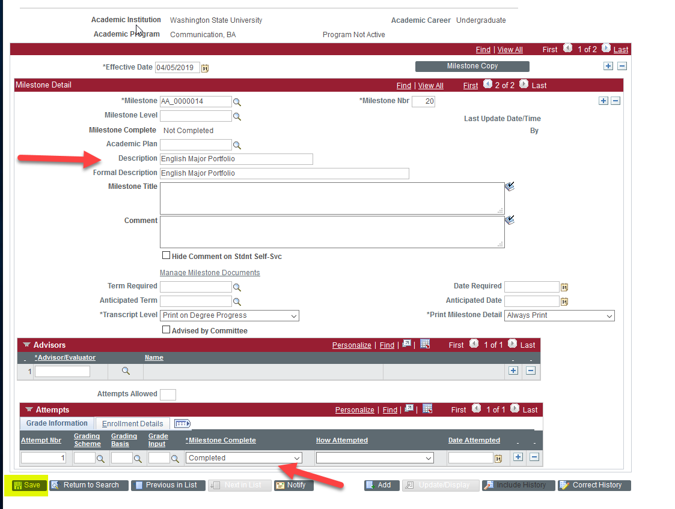

Entering Milestones
Review the description to make sure you have chosen the correct Milestone
Mark the Milestone as Complete
Click Save

Slide 43

Entering Milestones
Check the Academic Requirements Report to make sure the requirement is now satisfied

Slide 44

QUESTIONS?
If you have questions :
Please visit the graduations website: graduations.wsu.edu
Send an email to wsu.graduations@wsu.edu
Contact the graduations area if you would like additional training in:
Creating batch PDFs of the Academic Requirements
Entering batch milestones

