Slide 1
Academic Requirements Report Overview
Office of the Registrar
This is a narrated presentation. Please enable audio.

Slide 2
Objectives
At the completion of this training users will be able to:
Identify different types of Academic Requirement reports available and when they are used
Identify key areas of the Academic Requirement Report
Review Academic Requirements for missing requirement
Create an Academic Requirements report for former and/or discontinued students
Create an Administrative What-If Academic Requirements report

Slide 3
What’s in a name?
The Academic Requirements report is used to track the progress of a student toward degree completion.
In the past this has been referred to as an Advisement Report or a Degree Audit or DARS.
Renaming the report makes it clear that this is not just an advising tool, but a delineation of degree requirements.

Slide 4
Academic Requirement Reports
DEG – P : Academic Requirements- Preliminary– Report shows In-Progress courses for student requirements. In Progress Courses do NOT calculate automatically into the 120 credit requirement.
S – ADV : Student Self-Serv Academic Requirements- Report is used by my.WSU Student Center to create the Academic Advisement Report for students. Includes In-Progress courses
SSAD : Academic Requirements - Admin– Report displays for advisors, includes In-Progress courses for student requirements.
DEG – F : Academic Requirements - Final– Report does not include In-Progress Courses. Report DOES include all completed courses into the 120 credit requirement. Degree Audit is used by the Graduations Area during the conferring period to decide if a student has completed all requirements.
DEG – G : Degree Awarded Report – Report shows current Degree Audit for students whose degrees have already been awarded. Used to help students with requirements completed at WSU. NOTE: DEG-G Degree Audit may NOT accurately reflect past requirements.
DISC: Academic Requirements DISC– Report used to display requirements for students who have been discontinued when the student has not re-enrolled at WSU. NOTE: DISC Academic Requirements may NOT accurately reflect past requirements.
WIFAD : What If Report-Admin – Report used to determine requirements if student were in a different degree, major or requirement term

Slide 5
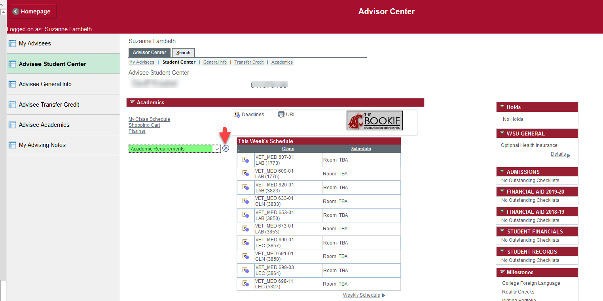
Generating the Academic Requirements Report
Available through Advisor Center

Slide 6
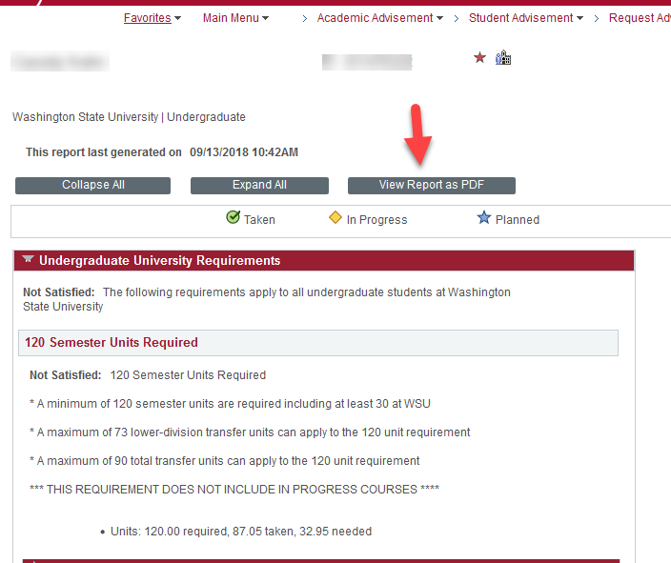
Generating an Administrative Academic Requirements Report
Click View Report as PDF

Slide 7
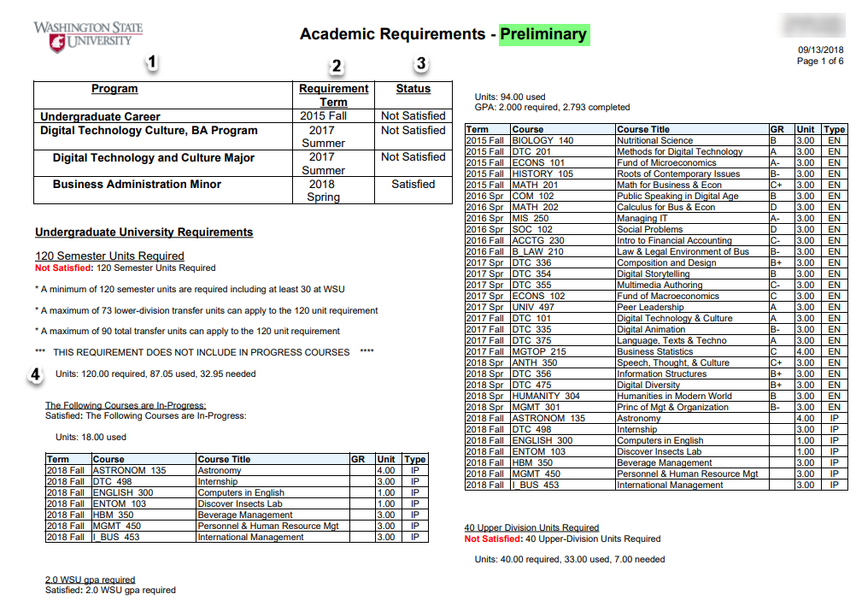
Reviewing the Academic Requirements Report
Displays the programs the student is certified in.

Slide 8
Reviewing the Academic Requirements Report
2. Indicates the certification term that the requirements are based on.
3. Indicates whether or not requirements have been satisfied.

Slide 9
Reviewing the Academic Requirements Report
4. Total credits do not include:
In progress courses
Courses that are currently being repeated
500 level courses

Slide 10
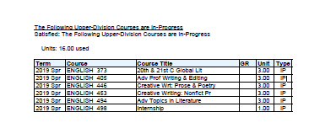
Reviewing the Academic Requirements Report
In progress courses are not added to the total for either the 120 credit requirement or the requirement for upper division credits. You will need to add the credits together to get the total

Slide 11
Reviewing the Academic Requirements Report
All Undergraduate students must meet UCORE requirements unless:
Student is in Honors College
Student is Post Bacc from accredited University
Student is in the GER student group
Notes:
All with the following exceptions
Complete HC requirements in lieu of
Already has completed a bachelor’s degree
Student is in the GER student group – admitted or readmitted prior to Fall 2015 and continuously enrolled – students who step away and are readmitted are admitted into UCORE

Slide 12
Reviewing the Academic Requirements Report
Courses taken by students who were previously in GERs or HONORS are applied to UCORE requirements via crosswalk.
Crosswalk information can be found on the graduations website and the advising 411 website
If 2009 GERs were complete – UCORE is considered complete
If Honors – all but Thesis is complete – UCORE all but CAPS can be considered complete
Notes:
A student who has completed the 2009 GER requirements may be considered to have completed the UCORE requirements. Students who were admitted prior to 2009 may submit a University petition to address differences in requirements.
IF a student completes all the Honors reqs except for thesis, all lower division UCORE reqs may be considered satisfied. When a student elects to drop from Honors, HC will contact the graduations area and a milestone will be entered completing all the LD requirements

Slide 13
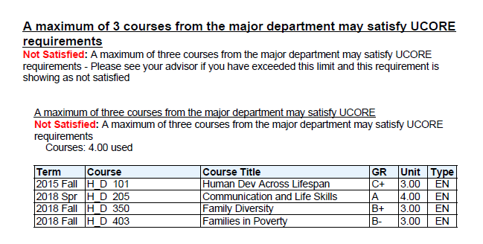
Reviewing the Academic Requirements Report
Students are allowed only 3 courses in their major prefix
Advisors can request that a different (non major prefix) UCORE course be directed to a requirement.
If the student is pursuing a BA in Humanities or a BA in Social Sciences the advisor may exclude a course from the major requirement in order for it to be used in UCORE.

Slide 14
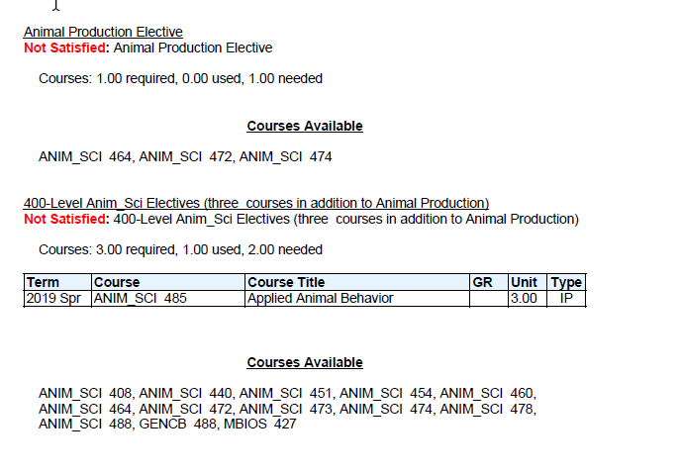
Reviewing the Academic Requirements Report
Note that areas with missing requirements are indicated in red.
Courses that meet the requirements are listed underneath the requirement line
If a student is pursuing a degree, major, or minor and there are no requirements listed, please contact graduations.

Slide 15
Reviewing the Academic Requirements Report
Summary
The Academic Requirements Report defines the graduation requirements
The AR reflects the academic requirements in place at the time of certification.
All requirements should be visible on the AR
In progress courses or previously completed courses that the student is currently enrolled in are not included in the 120 credit requirement line

Slide 16
Reviewing the Academic Requirements Report
Summary
In general, courses are not allowed to fulfill more than one major requirement. A course may be used to fulfill both a major and a minor requirement.
If a course can fulfill two requirements, it will fulfill the topmost requirement line in the AR.
Departments may allow exceptions to major, minor, or certificate requirements

Slide 17
Generating other Academic Requirement Reports
Generating Academic Requirement Reports
outside of Advisor Center

Slide 18
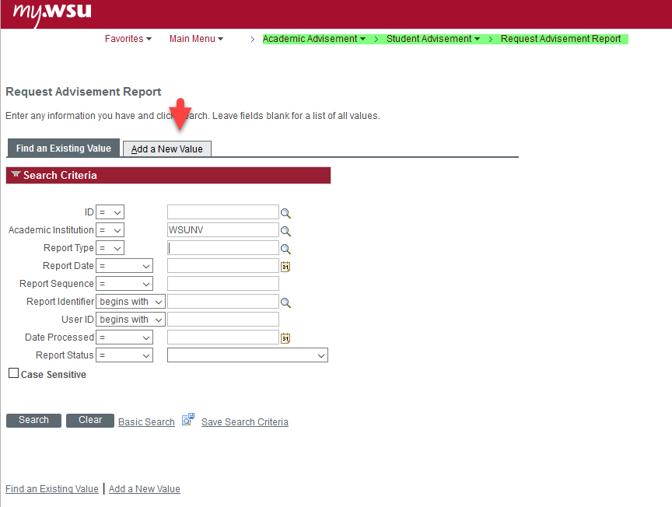
Generating an Administrative Academic Requirements Report
To create a new Academic Requirements Report

Slide 19
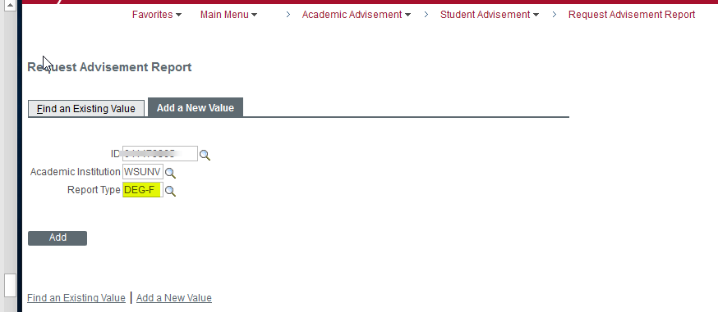
Generating an Administrative Academic Requirements Report
Enter the student ID
Select the Report Type
Click on Add

Slide 20
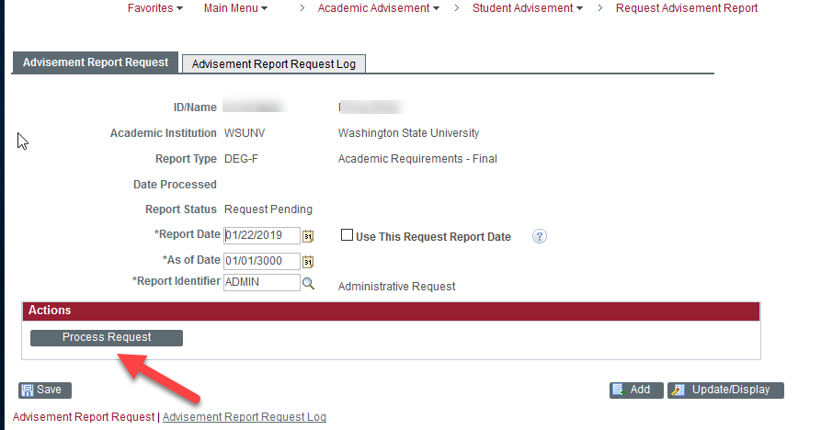
Generating an Administrative Academic Requirements Report
Click Process Request

Slide 21
Generating an Administrative Academic Requirements Report

Slide 22
Accessing a prior Academic Requirements Report
You can also look for a prior Academic Requirements report. This can be especially helpful for former students as it allows you to see where they left off.

Slide 23
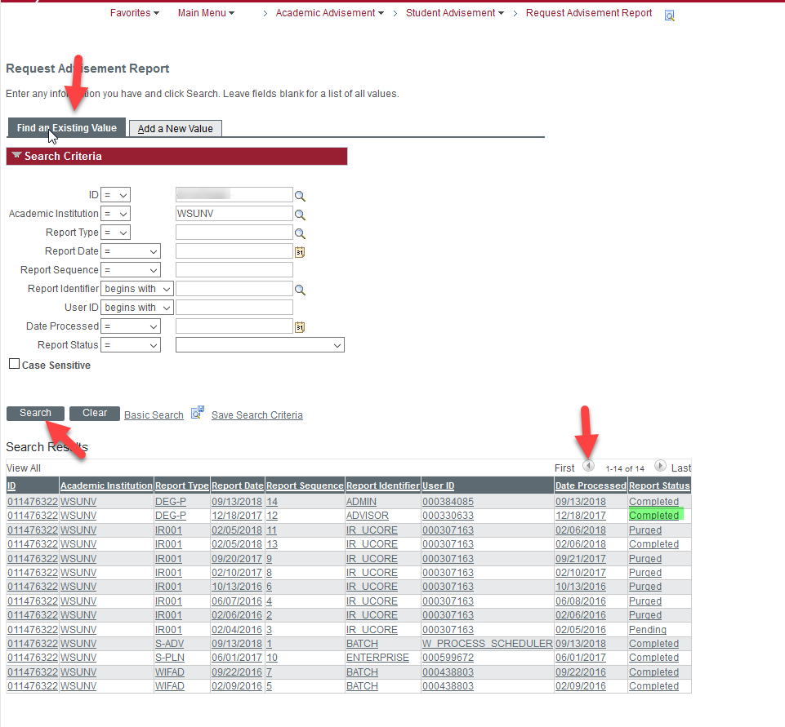
Accessing a prior Academic Requirements Report
Return to your request screen
Enter Student ID
Click on Search
Arrange by Date Processed by clicking on the column
Be sure to choose a report that shows Completed and not Purged

Slide 24
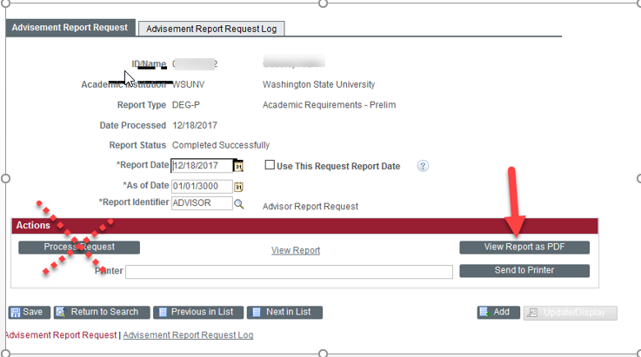
Accessing a prior Academic Requirements Report
Click View Report as PDF.
Do not click Process Request or you will update the report with current information

Slide 25
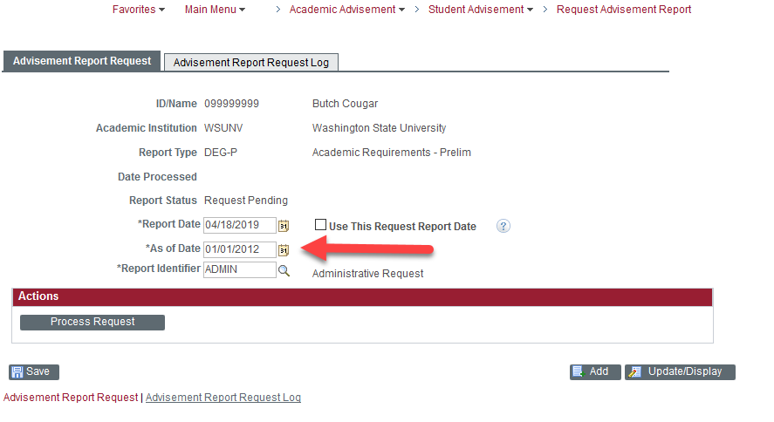
Accessing a prior Academic Requirements Report
If there is no old report for you to view, you can run a report based on a prior date.
This report can be especially useful for discontinued students if you use an “as of” date that is prior to the date the students was discontinued.
Follow the steps for running a new report (Add New Value). When you get to this page, change the “as of” date before you click on process request.
NOTE: Requirements are only coded for 2009 and forward.

Slide 26
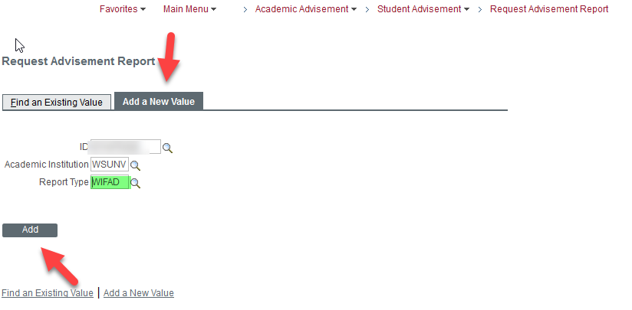
Administrative What-If
An Administrative What-If report can be used to determine requirements with dual degrees, additional majors and minors by requirement term.

Slide 27
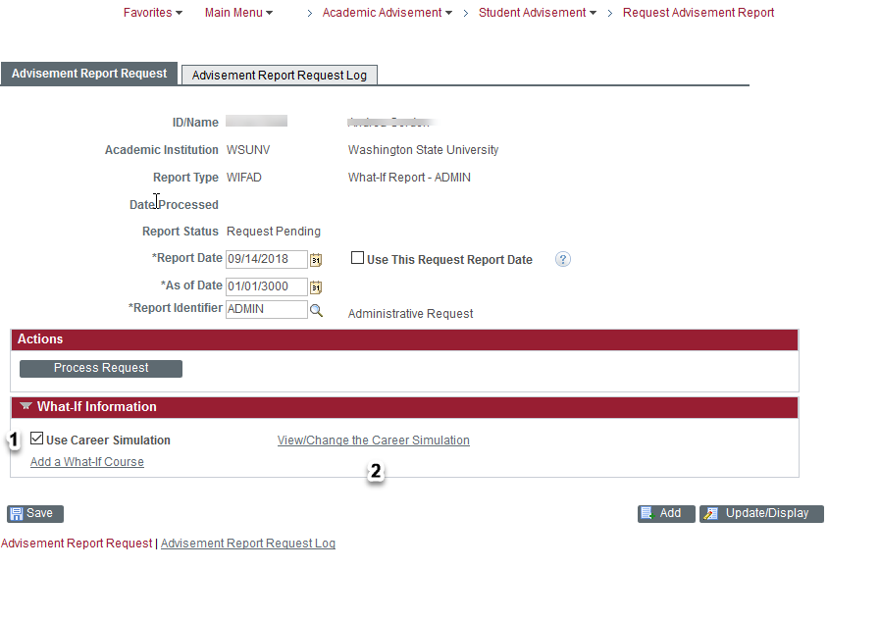
Administrative What-If
Check - Use Career Simulation
Click on View/Change Career Simulation

Slide 28
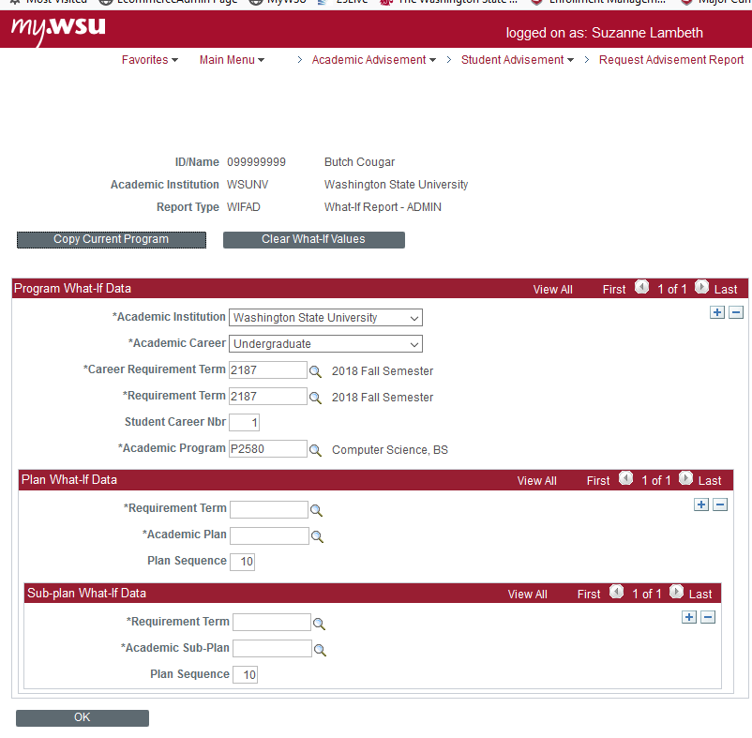
Administrative What-If
Enter Program What If Data
Career
Requirement Term
Academic Program Code

Slide 29
Administrative What-If
Enter Plan What If Data
Requirement Term
Academic Plan Code

Slide 30
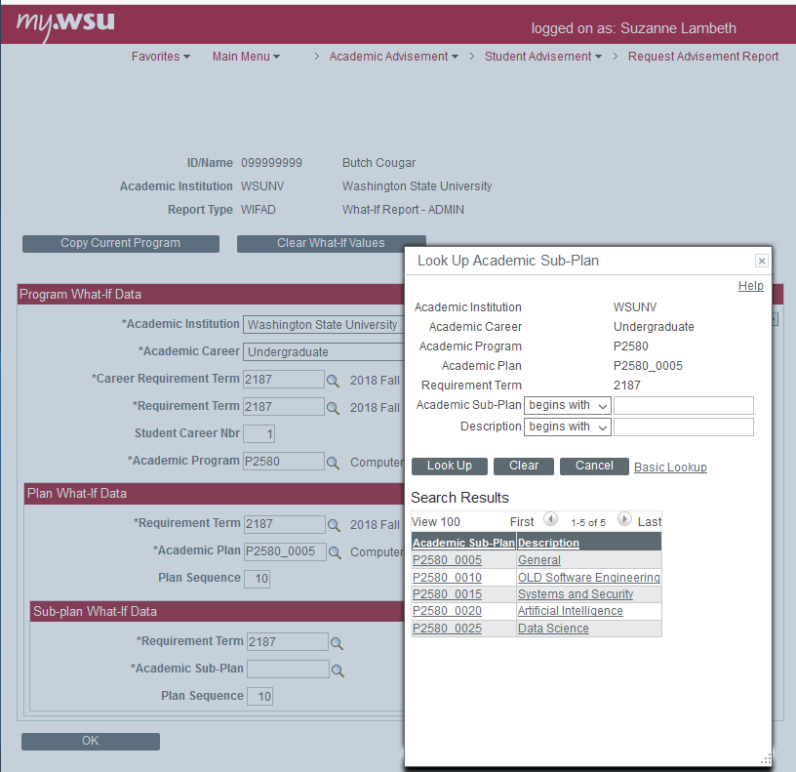
Administrative What-If
Enter Sub-Plan What If Data (if needed)
Requirement Term
Academic Sub-Plan Code

Slide 31
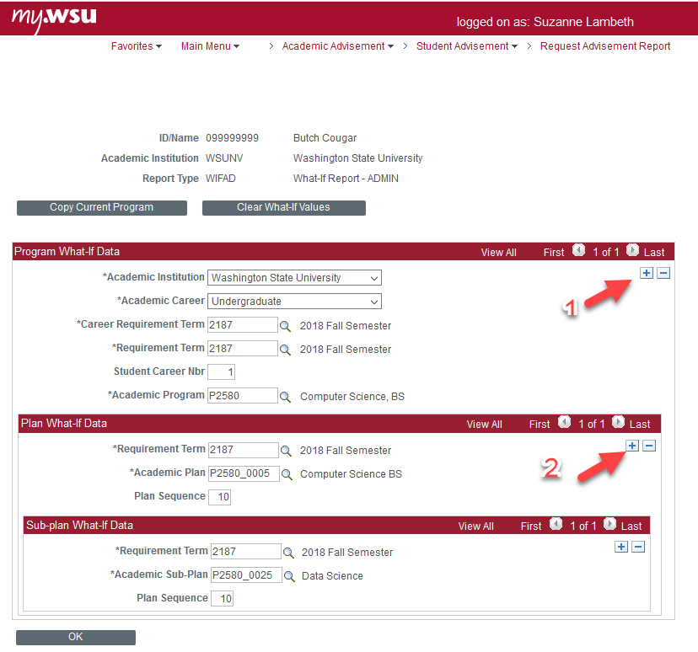
Administrative What-If
To add another degree, or a certificate, click on the plus (+) sign for the program(1)
To add an additional major or a minor click on the plus (+) sign for the plan (2)

Slide 32
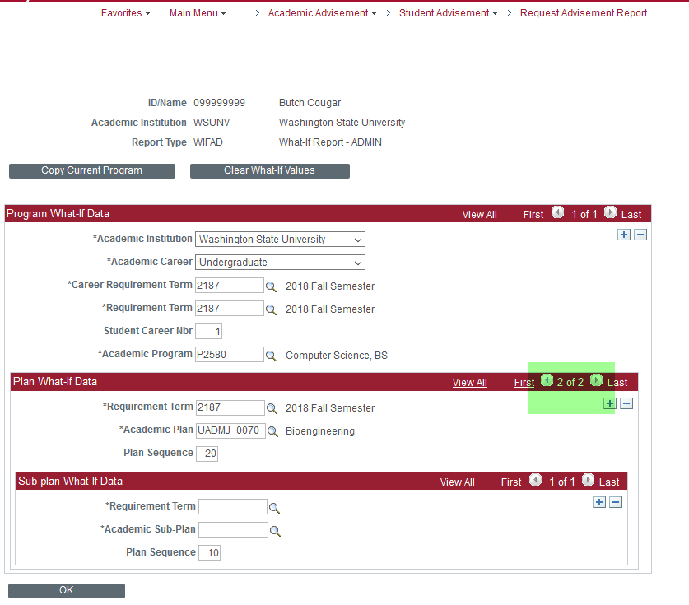
Administrative What-If
Adding Additional Major
One degree with an additional major

Slide 33
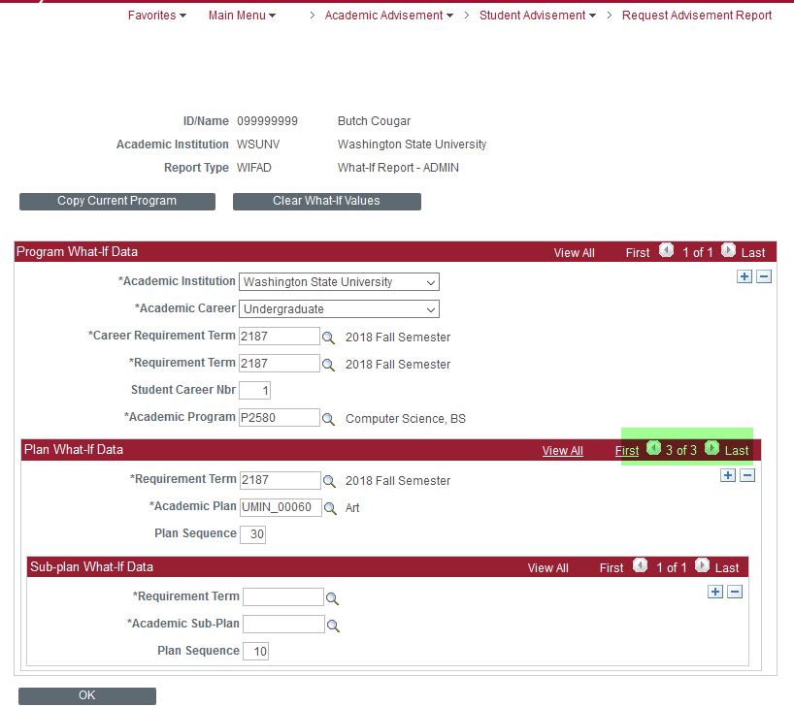
Administrative What-If
Adding a minor
One degree with an additional major and a minor

Slide 34
Administrative What-If
When all entries are completed click OK
Click Process Request
Click View Report as PDF

Slide 35
Additional Information
Batch PDFs
The graduations area can teach you how to run Batch PDFs of the Academic Requirements
Review students who have applied to graduate
Create PDFs for advising sessions
Review students who are not required to have an advising appointment

Slide 36
Academic Requirements Report
Summary
The Academic Requirements Report is a tool for you and your students to identify progress toward the degree.
There are multiple reports available for you to access.
If you believe there is an error in the AR, or if you wish to add text to provide clarification, please contact the Assistant Registrar for graduations.

Slide 37
Questions?
If you have questions :
Please visit the graduations website: graduations.wsu.edu
Send an email to wsu.graduations@wsu.edu

